Slide 1
Carib Brewery Grenada Limited
SCTCM Report
August 2026

Slide 2


GRENADA Safety Pyramid
CBG, SAFETY REPORT, august 2026
Fatalities
0
0
LTIs
0
0
Accidents
RWC MTC FA VA FLT PD
RWC MTC FA VA PD
2
0
3
0
0
0
0
0
0
0
0
UC-UB Reports / % of YTD Budget
Reports YTD
% of YTD Budget
Reports YTD
% of YTD Budget
6533
172%
0
0
UC-UB Closure Rate YTD
76%
0
Employees
Contractors

Slide 3
HSE KPI’S – UC-UB REPORTS
CBG, SAFETY Report august ‘26
CBG UC-UB Reporting 2026 Actual vs Budget & 2025

Slide 4
HSE KPI’S – ACCIDENTS
CBG, SAFETY REPORT, Aug 2026

Slide 5
KPI’S – AUDITS
CBG, SAFETY REPORT, Aug. ’26
CBG Audits 2026 Actual vs Budget

Slide 6
Production- CAPEX Status AUGUST 2026
Name | Description | Status | Timeline
New Pasteurizer | Install new tunnel pasteurizer | Commissioned in June 2026 Punch list items to be completed September 2026 | 18-Jul
New Boiler | Refurbish Boiler #2 | P.O submitted for required parts, pending ETA from supplier. | 30-Dec
New Silo | Install 70-Ton Silos and Malt handling | Quote received from Kunzel and Tonsen, Review of technical comparison and CAPEX to be completed in September and recommendation put forward in October. | 31-Mar 2027
High Gravity Brewing | Install relevant equipment to introduce high gravity brewing at CBG | Carboblender: Received proposals from Alfalaval and SPI, awaiting quotes from Promach built and Krones Aldox DAW module: Received proposal from Sulca. Discount to be negotiated and Capex request submitted. | 30-Mar 2027
Plastic Pallet Upgrades | Replace wooden pallets in production and sales with Plastic pallets. | Capex to be submitted for qty. 1920 @ US$75 each (ex factory) from ORBIS | 30-Dec
Well rehabilitation | Rehabilitate Well 1 and 2 | To confirm scope of well rehabilitation - pending technical assessment by third party. | 31-Oct

Slide 7
Production 2026- YTD KPI’s

Slide 8
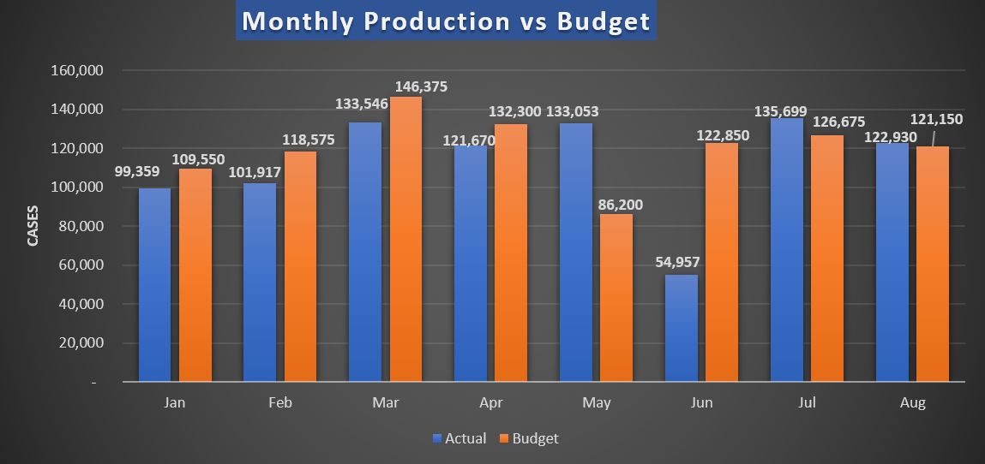
Production- Packaging Line
August actual: 1,780 cases above budget.

Slide 9
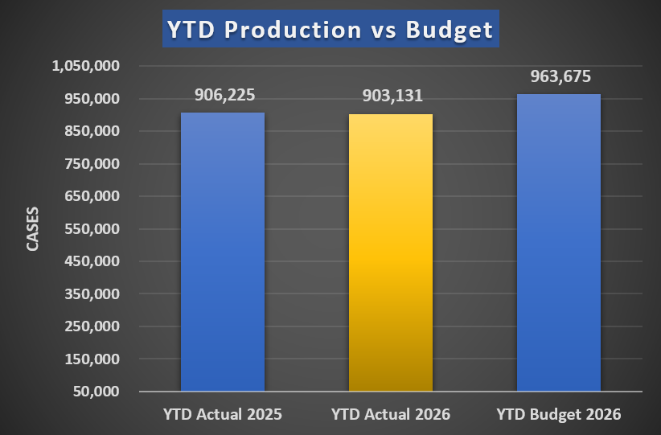
Production- Packaging Line
YTD actual –60,544 cases under budget
YTD 2026 – 3,094 cases under 2025 Actual cases

Slide 10
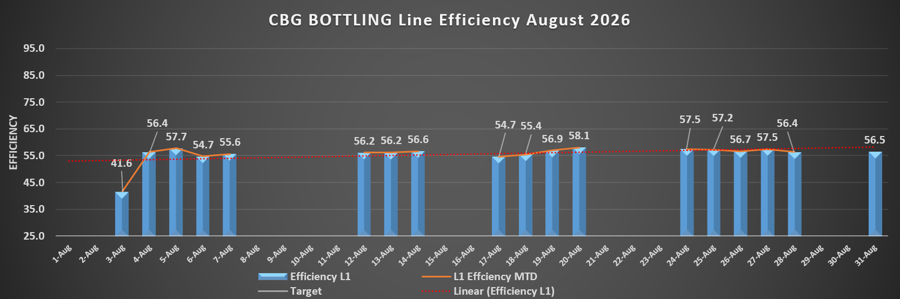
Production- Packaging Line

Slide 11
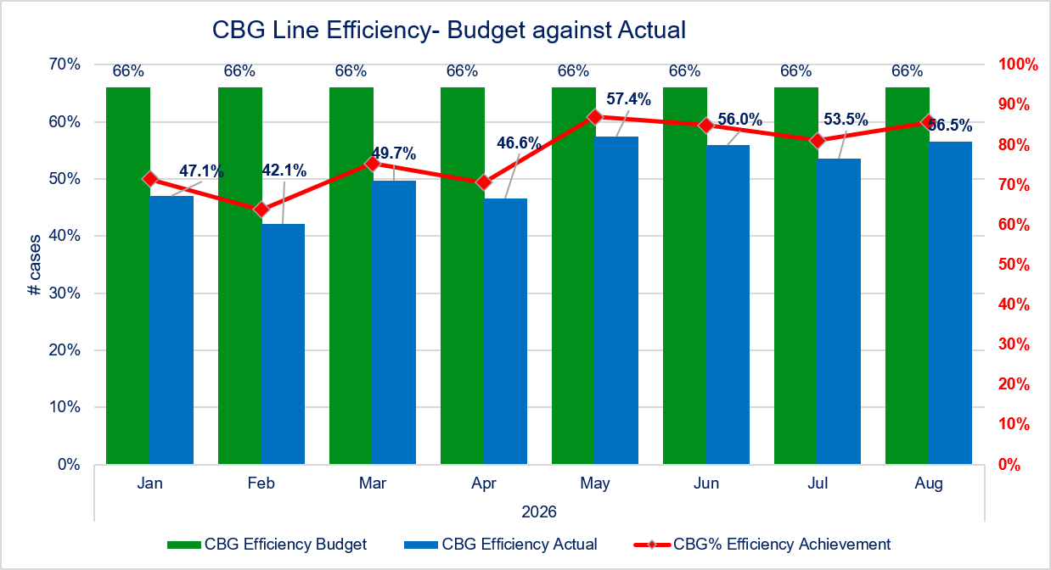
Production- Packaging Line
Line efficiency –56.5%
9.5% below target for August.
CBG Efficiency Budget
CBG Efficiency Actual
CBG% Efficiency Achievement

Slide 12
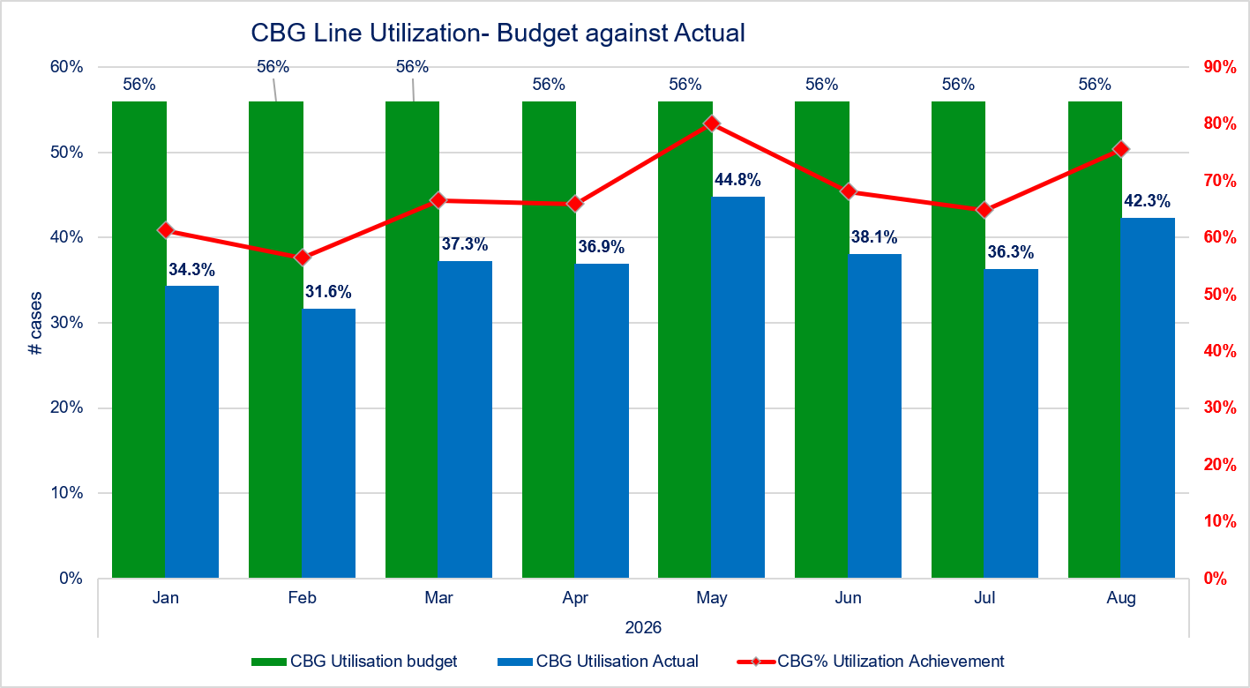
Production- Packaging Line
Line Utilization –42.3%
13.7% under target for August.

Slide 13
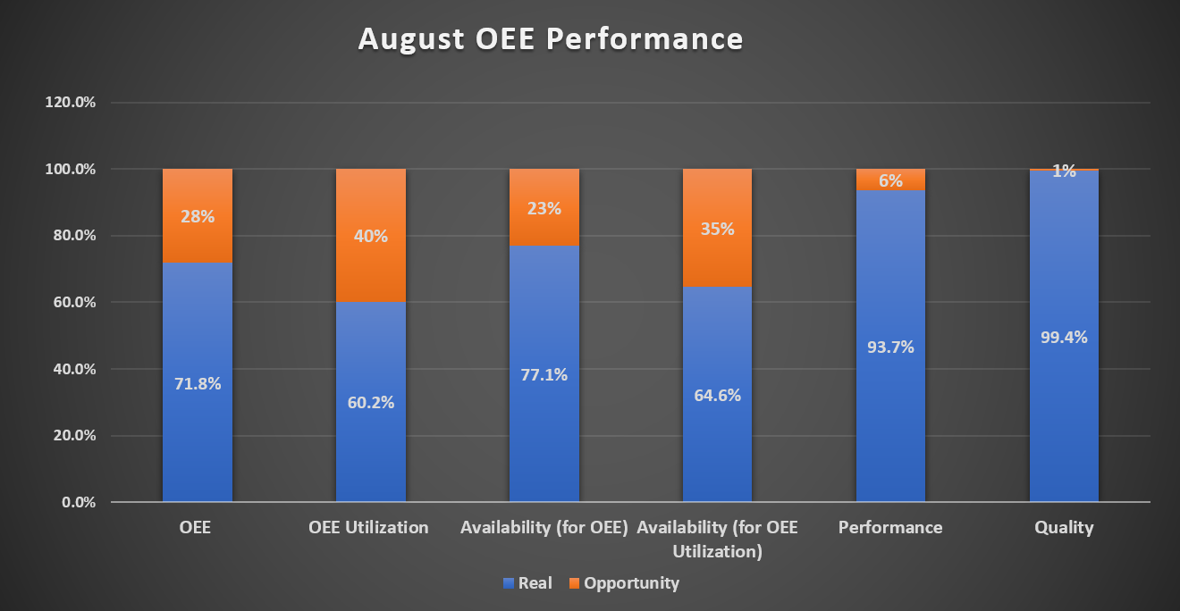
Production- Packaging Line –OEE
August OEE Actual- 71.8% (0.2% under target)

Slide 14
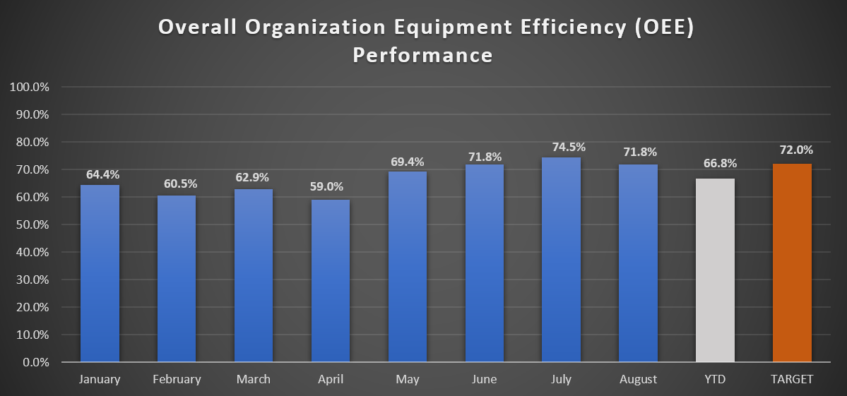
Production- Packaging Line –OEE
August OEE YTD – 66.8% (5.2% under target)

Slide 15
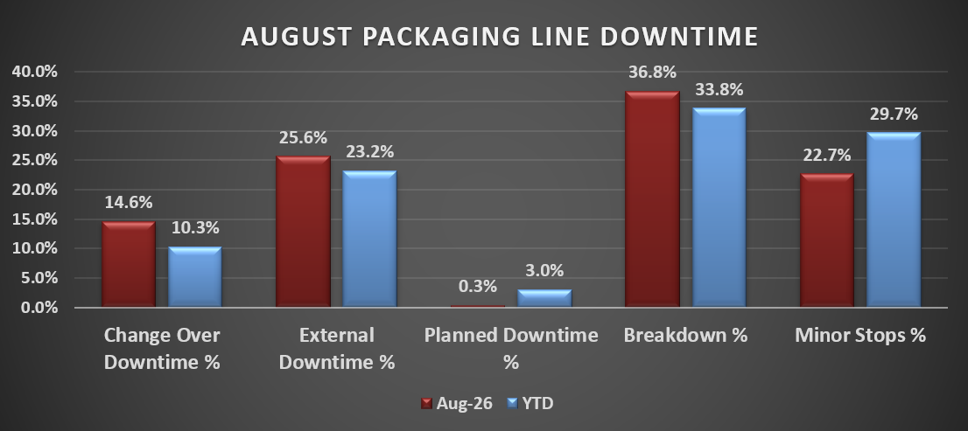
Minor stops: (34.5hrs)
  High EBI rejection
  Uncaser head hitting crates
  Fallen bottles in EBI Star wheel and OSW
  Fallen bottles on Conveyor lines (shuffler, EBI infeed)
  Fallen/broken bottles jamming in Washer infeed and discharge flaps
  High rejection due to labels
  Label adjustments (misaligned, flagging, missing & start up adjustments)
  Low temperature on pasteurizer
  Crowner stuck in chute/hopper
  Crowner self flushing
Breakdowns: (55.9hrs)
  Damaged card on labeler
  Adjusting drive belt for carton sealer
  EBI infeed conveyor malfunction
  Sealer malfunction - not sealing
  Repairing bent bottle pad on labeler
  Missing labels
  Magazine repairs and adjustment
  Pumps #4 & #5 cut off (flap jammed) on pasteurizer
  Issues with filler rotating plate
  Crowner not releasing crown
  Communication fault on filler
  Communication problem between EBI and filler (sensor malfunction)
  False EBI rejection
  Uncaser head malfunction
External: (39hrs)
  Product Delay (6.4hrs)
  Washer loading (4.7hrs)
  Lunch break due to lack of manpower (4.6hrs)
  Space availability constraints (4.5hrs)
  High rejection due to rewashed bottles (4.1hrs)
  Waiting on crates (1.2hrs)
      28 Change over: (22.2hrs)
PRODUCTION- PACKAGING LINE

Slide 16
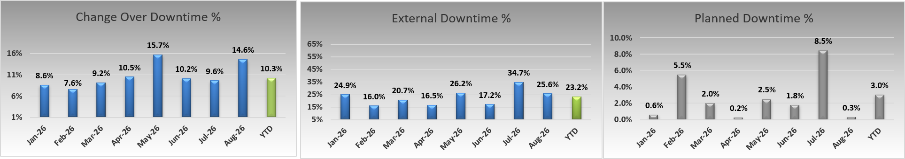
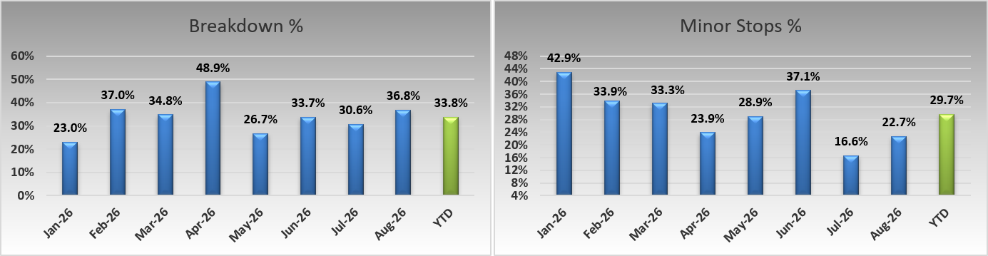
Production- Packaging Line
Organizational Losses
Technical Losses

Slide 17
PRODUCTION- PACKAGING LINE
Pareto Line 1 Timestealers

Slide 18
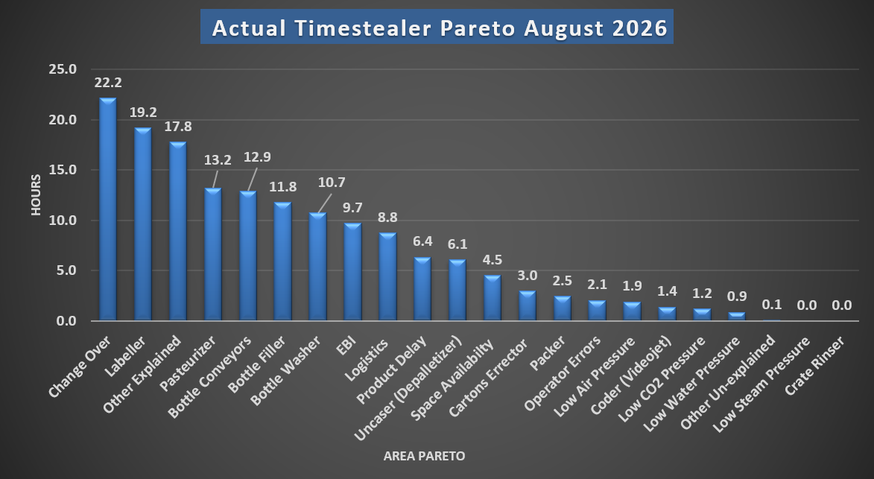
June 2026 Timestealers
Top 4 Time Stealers
Change Over: Product change overs.
Labeler: Electrical panel power supply failure (9.3hrs), magazine repairs and adjustment (2.3hrs).
Other Explained: Washer loading (4.7hrs), lunch break due to lack of manpower (4.6hrs).
Pasteurizer: Waiting on dry run (4.8hrs), pump malfunction (trip/cut off)- #3, 4 & 5 (3.6hrs), flap jamming(1.3hrs).

Slide 19
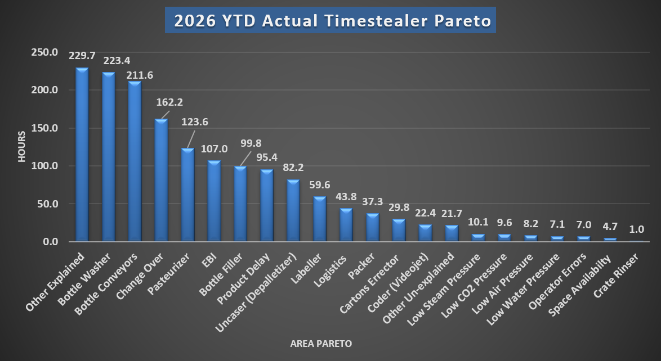
Top 4 Timestealers and Actions to Address
Top 4 Equipment Time Stealers:​
Other Explained: Low water supply on plant due to NAWASA issue, Starmalt relabeling, product preparation, washer loading, townhall meeting, lunch break due to insufficient manpower, absenteeism of Filler operator and staff punctuality.
Bottle Washer: Significant downtime was experienced on the bottle washer in Feb and March. During the shutdown in June for pasteurizer installation, San Martin also did works on the bottle washer. There has been a marked improvement in the adequacy of the wash as well as notable decrease in downtime caused by the washer. Monitoring will be ongoing.
Bottle Conveyors: Issues were predominantly at the infeed and discharge conveyors from the EBI with various communication faults experienced. This was most significant in January, with noted improvement after issues were addressed by OEM. Other issues at labeler infeed were rectified after replacement of a damaged sprocket. A full review of conveyors will be done in Q3 to determine any other areas that require action. There were a lot of instances of fallen bottled inside shuffler.
Change Over: Product change overs.

Slide 20
Production- Packaging Line
Two (2) biggest downtimes (Details & resolution) – AUGUST 2026
Labeler downtime analysis (19.2hrs) | Response
Electrical panel power supply failure (9.3hrs) Magazine repairs and adjustment (2.3hrs) | Investigation initially indicated a possible device network card error. Further troubleshooting identified a power supply failure in the electrical panel as the root cause. The correct addresses were assigned to the respective devices, restoring communication and operation. An old prong was modified and retrofitted to replace the damaged one. An OEM comprehensive audit is scheduled to assess the magazine and provide recommendations.
Pasteurizer downtime analysis (13.2hrs) | Response
Waiting on dry run- routine pasteurizer verification (4.8hrs) Pumps #3, #4 & #5 tripping (3.6 hrs); flap jamming (1.3 hrs) | Waiting for the pasteurizer dry run to be completed and the start-up results confirmed. Flap jamming was identified as the cause of the pump trips. The flaps were checked for alignment, lubricated, and adjusted to maintain equal spacing and prevent further jamming.

Slide 21
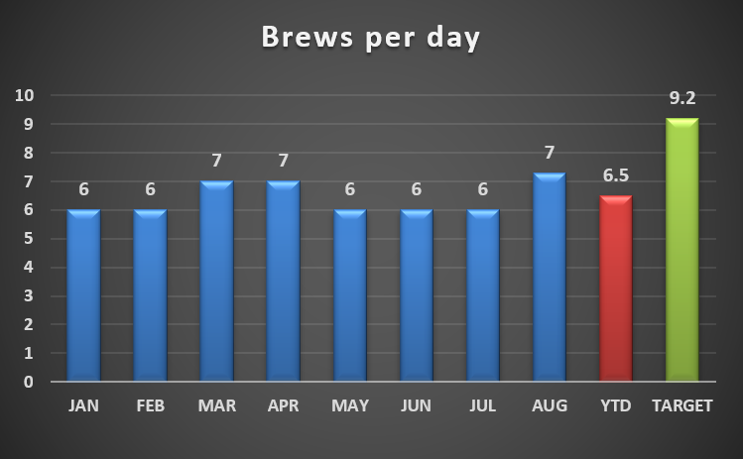
Production – Brewing Performance 2026
Average brews per day for August was 7.3.
YTD brews per day is 6.5.

Slide 22
Brewing Issues- Forward Approach
 | Area of Focus | Plan
1 | Malfunctioning valves at wort kettle | Requisition under review and awaiting final approval.
2 | Steam and air supply interruptions | Brewing was affected by an air compressor failure and periods of low steam pressure. Shift men responded to the interruptions and restored normal operating conditions.
3 | Mash tun slide valve | Servicing was completed, with improved performance observed in September.
4 | Faulty on wort external boiler emptying valve | Valve repaired to restore proper operation.

Slide 23
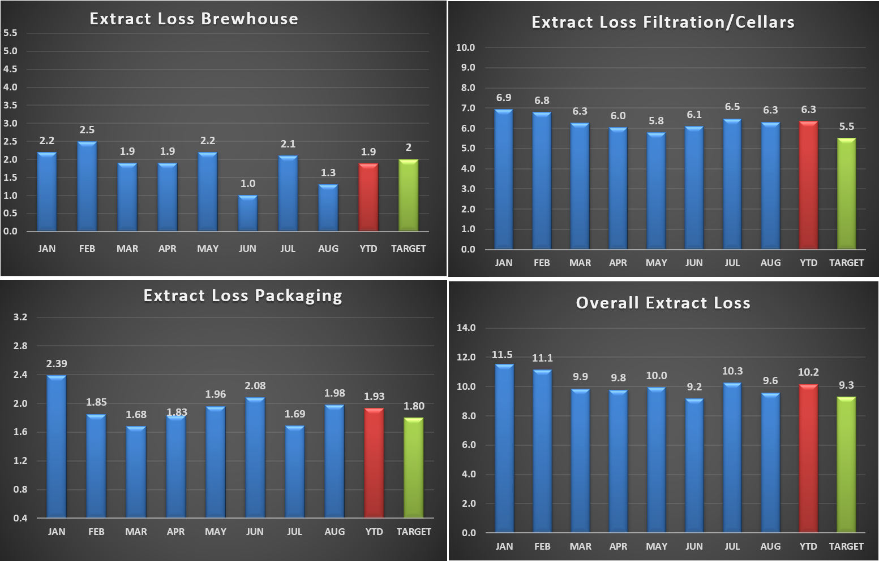
Production – Brewing Performance- Extract Losses
Brewhouse Extract loss – MTD- 98.7% ( within target)
Filtration/Cellars Extract Loss - MTD- 6.3% (0.8% above target)
Packaging loss – MTD- 2.0% (0.2% off target)
Overall Extract loss – MTD- 9.6% (0.3% above target)

Slide 24
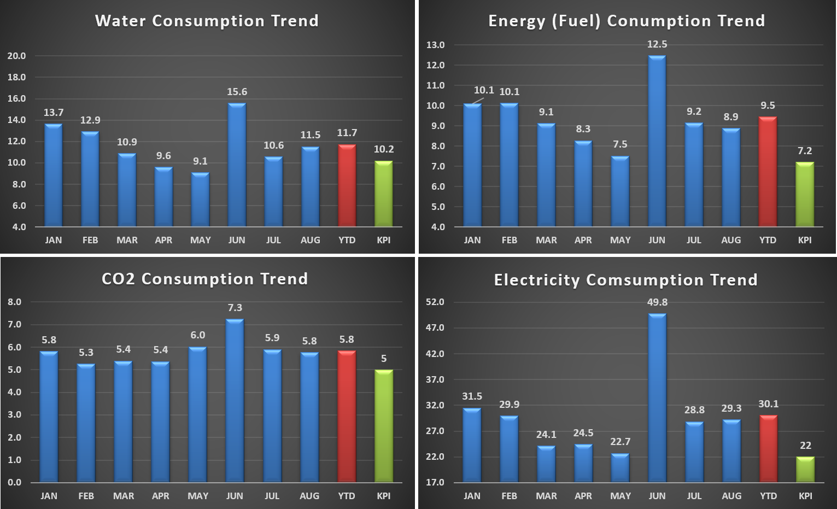
Supply chain – utilities monthly breakdown
Water – MTD- 11.5% (1.3 above target)
Fuel – MTD- 8.9% (1.7 above target)
CO2 Consumption - MTD- 5.8% (0.8 above target)
Electricity – MTD- 29.3% (7.3 above target)

Slide 25
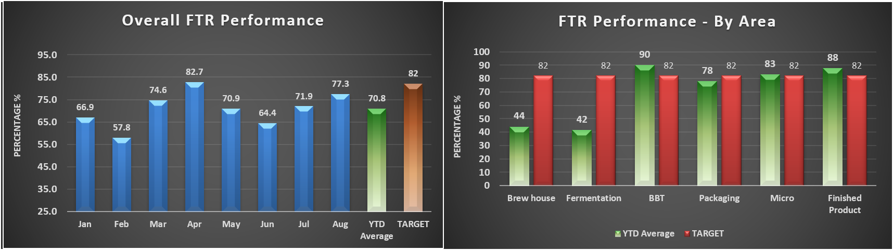
QUALITY- FTR
AUGUST FTR was 77.3% versus an 82% target. YTD 2026: 70.8%.​
​
Key factors: ​
Brewing 60% (Brewing Time 66%, Cast Gravity 92%,Aeration Level 100%)​
Fermentation –48% (Fermentation Speed 77%, FVSV Fill duration 89%, Yeast Dosage 100%, Yeast Storage 70%, Pitch Yeast 100%)​
Micro –82% (Micro Pack-Micro Tunnel 100%, Micro Beer-Micro Ferment 82%)​
Finish Product –98% (Colour 98%, PG 100%, ISO-H 100%, TIPO 100%)​
Packaging –80% (PU 85%, Fill Volume 100%, Packaging Index 80%)​
BBT- 96% (Colour 99%, PG 99%, CO2 99%, DO 100%, Haze 100%)

Slide 26
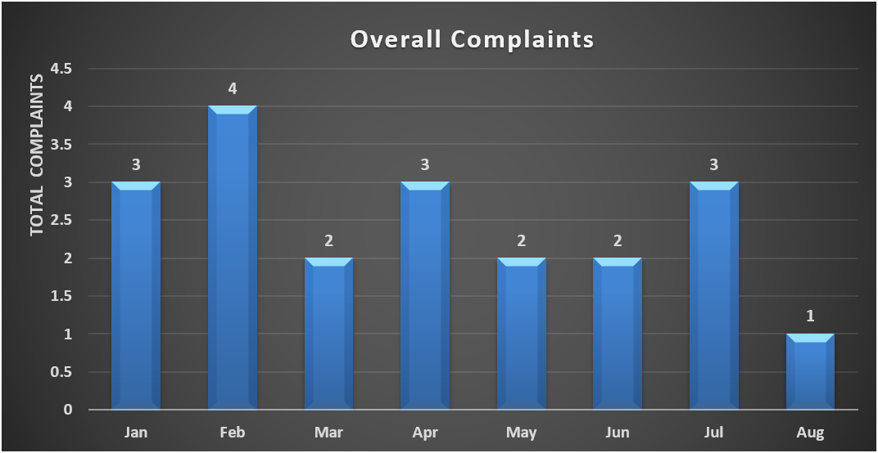
QUALITY – LOCAL CONSUMER COMPLAINTS
Complaints
1 customer complaint received for August 2026.

Slide 27
QUALITY – LOCAL COMPLAINTS

Slide 28
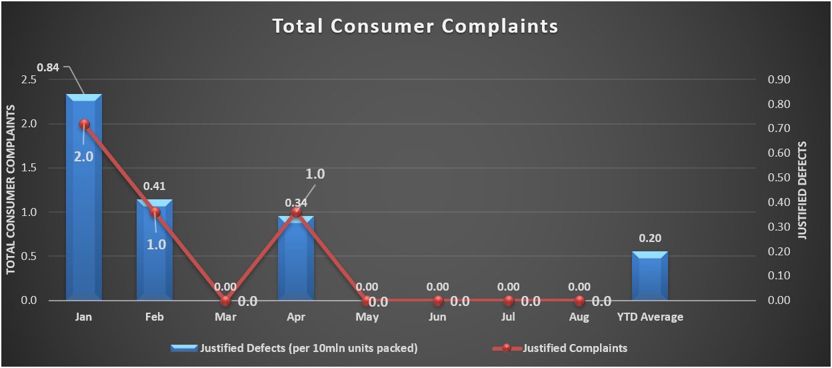
QUALITY – LOCAL CONSUMER COMPLAINTS

Slide 29
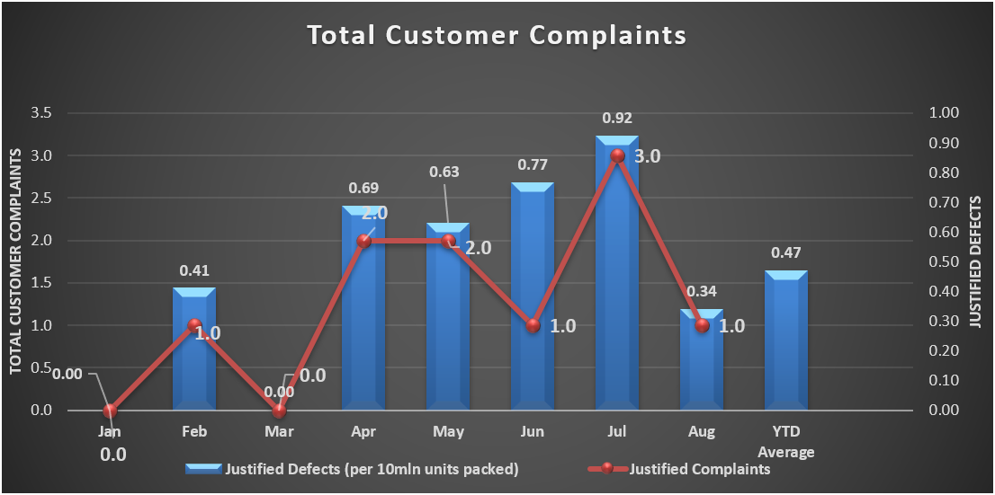
QUALITY – LOCAL CUSTOMER COMPLAINTS
There were 1 customer complaint received for August 2026.

Slide 30


